Slide 1
Test utilization

Slide 2
Test Utilization 2
Test utilization refers to the appropriate and effective use of laboratory tests to optimize patient care. Advocating for the clinical laboratory through test utilization involves demonstrating the value and impact of thoughtful test ordering and result interpretation.
By advocating for the clinical laboratory through test utilization, you position the laboratory as a key partner in delivering high-quality, cost-effective healthcare.
Emphasizing the importance of evidence-based testing decisions and the impact on patient outcomes strengthens the laboratory's role within the broader healthcare ecosystem.

Slide 3






How Test Utilization can help advocate for the clinical laboratory
REDUCE INSURANCE DENIALS
IMPROVE COST EFFECTIVENESS/REDUCE OVERALL COST
REDUCE OVER-TESTING AND UNDER TESTING
IMPROVE PATIENT OUTCOMES AND RESOURCE EFFICIENCY.
ENHANCED OVERALL PATIENT CARE
RE-INFORCE THE VALUE OF THE CLINICAL LAB/ENHANCED VISIBILITY

Slide 4
Test Utilization Dashboard:
Vitamin-D Utilization
Example Dashboard

Slide 5
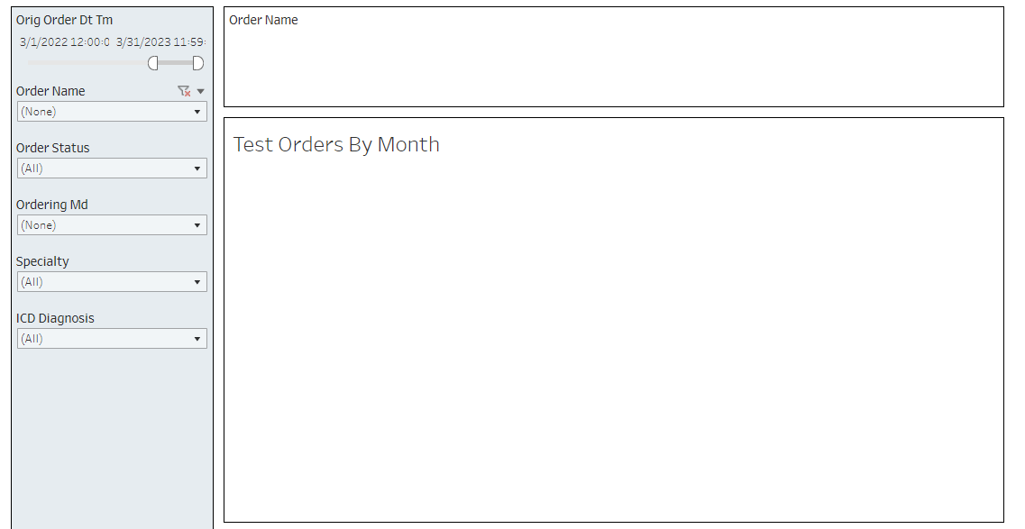
Test Utilization Dashboard-Overview

Slide 6
Dashboard Quality Metrics
Monthly trend by test volume
By Ordering MD
By Specialty
Month over month percent change in test orders

Slide 7
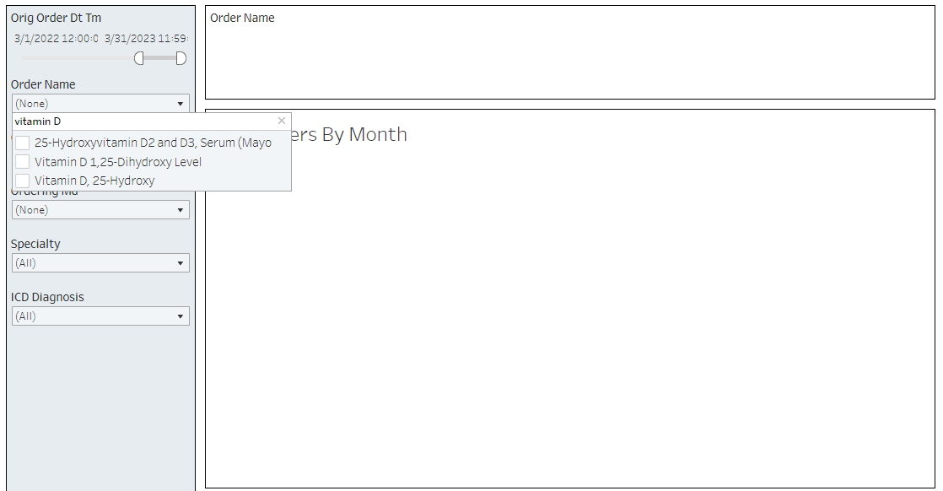
Filter by Test Name-Vitamin D

Slide 8
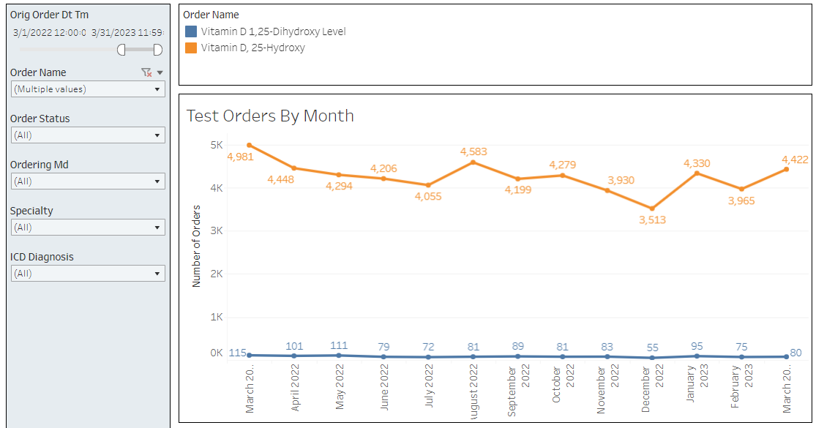
Vitamin D Utilization
March 1st, 2022-March 31^{st,} 2023

Slide 9
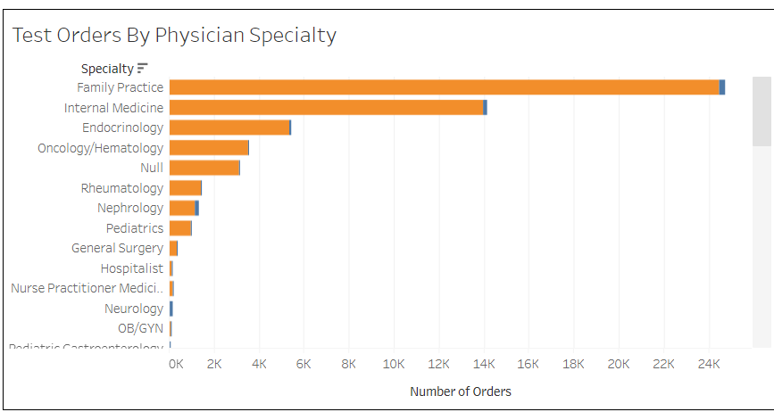
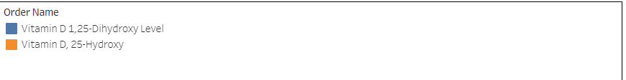
Vitamin D Utilization by Specialty

Slide 10
Example Cost per test and Potential Savings

